Slide 1
Hidden Markov models Training session
February 21st 2025
Arturo Esquivel, Fanny Dupont, Marco Gallegos Herrada, Vinky Wang, Sofia Ruiz Suarez, Eric St Marie.

Slide 2
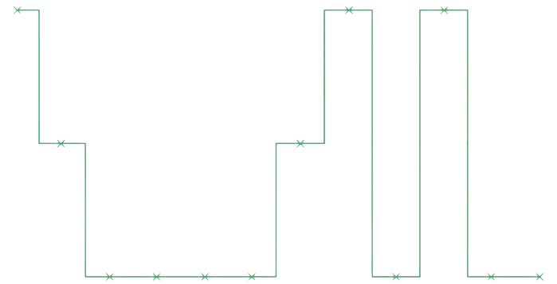
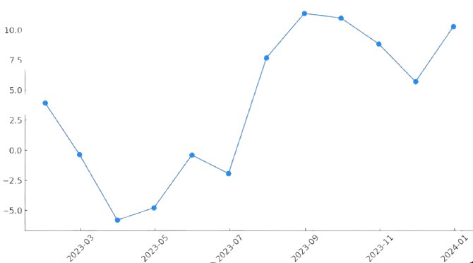
Hidden Markov models:
Time-series models​
observation arise from a hidden Markov process​
Markov process = the future depends only on the present

Slide 3
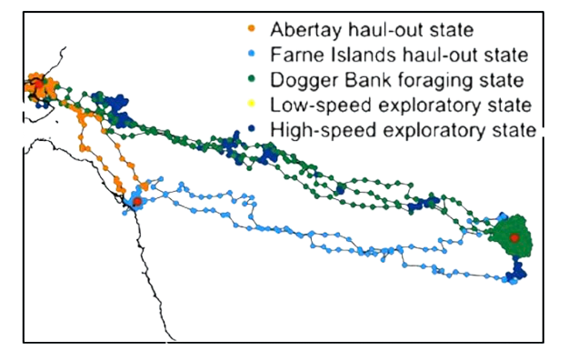
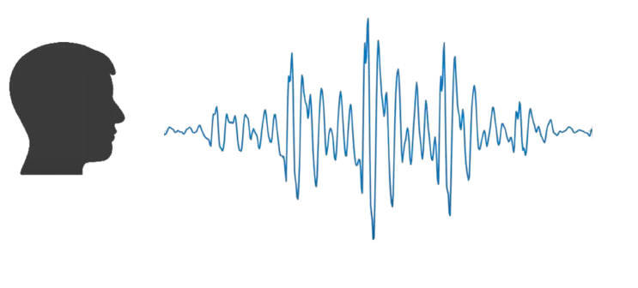
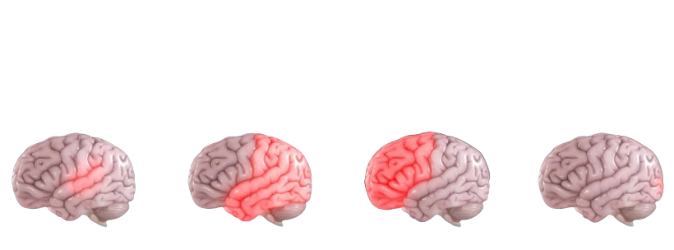
Speech Recognition
Behaviour segmentation
Michelot et al. 2017
Credit card fraud detection
Alzheimer’s disease progression stage identification:
Srivastava et al. (2008)
Lin and Song (2021)

Slide 4
Two processes:
Observation process
Hidden states process
Markovian
Number of states is finite.
Each transition from one state
to the other is assigned a probability
Signal
Distributed depending on the states at the same time

Slide 5


Markovian process:
Example: weather in Vancouver
Only two types of weather:

Slide 6
Markovian process:
Example: weather in Vancouver on day t is S_{t}
P(S_{t}= | S_{t-1} = , S_{t-2}= , …., S₀= )

Slide 7
Markovian process:
Example: weather in Vancouver on day t is S_{t}
P(S_{t}= | S_{t-1} = , S_{t-2}= , …., S₀= ) = P(S_{t}= | S_{t-1} = )
Markov property: weather from tomorrow only depends on the weather from today
The probability that it is not rainy on day t only depends on the weather at day t-1

Slide 8

Markovian process:
Example: weather in Vancouver
0.75
0.25
0.85
0.15

Slide 9

Hidden Markov model:
Example: weather in Vancouver
- Imagine you are in an appartement with a window very high up for several days
You can't see outside, but you can see the light filtering through
You’re trying to figure out what the weather is like outside (rainy, cloudy).

Slide 10
brightness
Hidden Markov model:
Example: weather in Vancouver
Observation: brightness of the light coming through the window
Day 1
Day 2
Day 3
Day 4
Day 5
Day 6
Day 7
Hidden state: weather outside

Slide 11
Hidden Markov model:
Example: weather in Vancouver
Brightness of the light coming through ≠ Weather:
Brightness is not a direct observation of rainfall:
dim lighting can be associated with rainy weather but it could also be because the sun is low or behind clouds

Slide 12
Hidden Markov model:
Example: weather in Vancouver
The weather follows its own dynamic
The distribution of the brightness depends on the weather:
When , the brightness might follow a normal distribution with mean=50.
When , the brightness could be much lower, around mean =30.

Slide 13
Hidden Markov model:
Example: weather in Vancouver
Identify how often it is likely rainy versus not rainy
Understand how often the weather switches between states
Reconstruct the most likely sequence of actual weather states (rainy/not rainy) from the observed brightness: state decoding

Slide 14
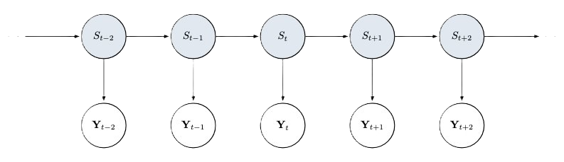
Hidden Markov model:
Basic structure
Hidden state: weather outside
Observation: brightness of the light coming through the window

Slide 15
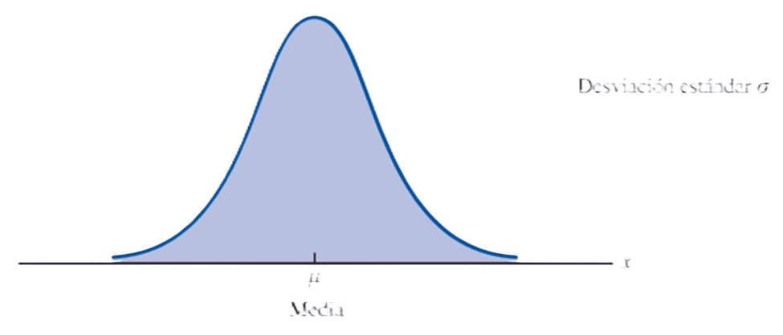
Hidden Markov model:
The aim is to learn the hidden through the observed process
Hidden state
Observation
we establish a probabilistic relationship between both processes

Slide 16
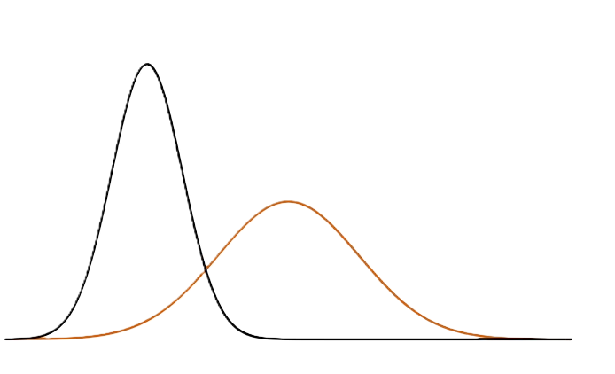
State-dependent distributions:
Brightness

Slide 17
State-dependent distributions:
Specified with different parameter values
Brightness

Slide 18
Hidden Markov model:
Can be fully characterized by:
The number of states /
The initial distribution of the Markov process
The transition probabilities
The state-dependent distributions
0.75
0.25
0.15
0.85
/

Slide 19
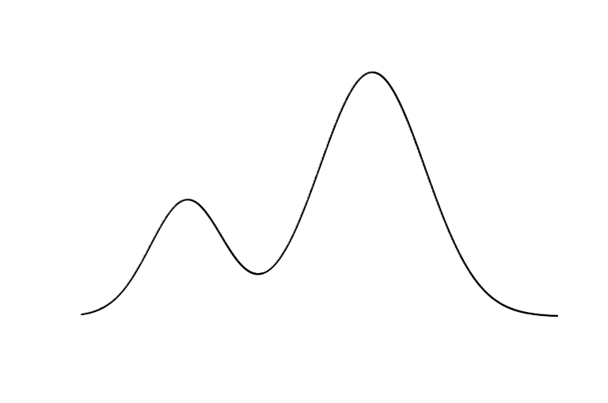


Maximum Likelihood:
Specifying the model
We look for the parameter values (theta) that best explain our data
The "most likely to have produced the data observed"
The likelihood is maximized using numerical algorithms (multiple starting values)

Slide 20
State decoding:
Making sense of the HMM
brightness
Often the goal is to identify (classify) the state process
Probabilistic algorithms identify the sate sequence best explaining the data observed
Expert "interpretation" of the states
Day 1
Day 2
Day 3
Day 4
Day 5
Day 6
Day 7

Slide 21





Covariates:
Incorporating additional information
e.g., time of the day
In state-dependent distributions:
In transition probabilities:

Slide 22
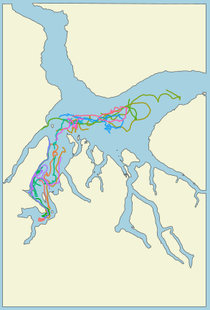
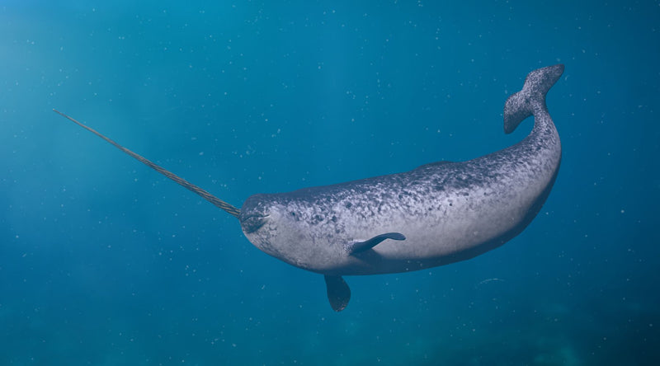
Hidden Markov models R tutorial:
Narwhal data
Dr. Marianne Marcoux (Fisheries and Oceans, Canada)
GPS coordinates over time (observed)
Used to infer behaviours (hidden), e.g., travelling or foraging

Slide 23
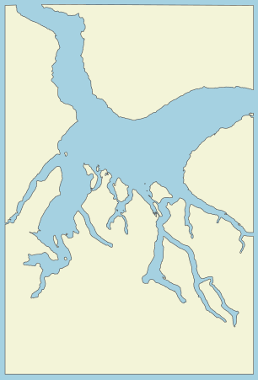
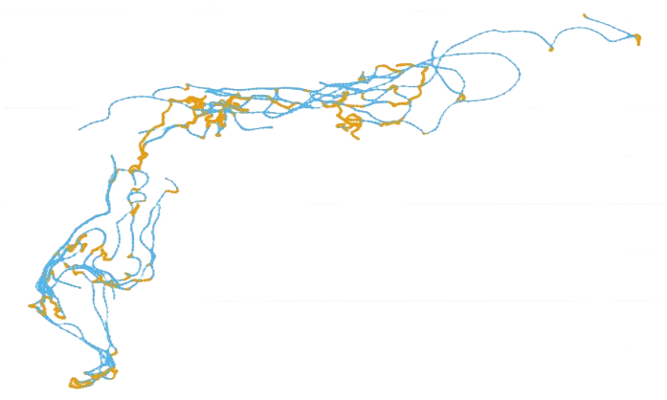
Hidden Markov models R tutorial:
Narwhal data
Dr. Marianne Marcoux (Fisheries and Oceans, Canada)
GPS coordinates over time (observed)
Used to infer behaviours (hidden), e.g., travelling or foraging

Slide 24
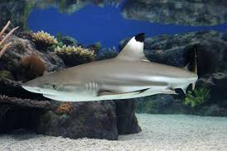
Hidden Markov models R tutorial:
Blacktip reef shark
Accelerometer data, activity measurements (observed)
Used to infer behaviours (hidden), e.g., travelling
Incorporate covariates for transitions between states

Slide 25
Thank you!

